Slide 1
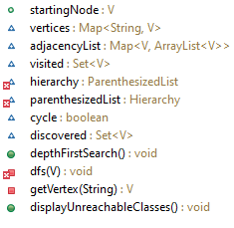
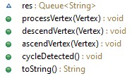
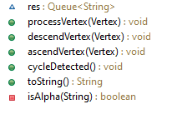




Graph.CLASS
ParenthesizedList.CLASS
Hierarchy.CLASS
DFSActions.CLASS
DirectedGraph.CLASS
Main.CLASS
Vertex.CLASS

